Slide 1
GAN Violence: A Brief Introduction of GAN, CGAN and IRGAN
Speaker: Kangqi Luo
2017/06/07

Slide 2
Contents
Recap: Generative Adversarial Networks
CGAN: Conditional version of GAN
IRGAN: Adversarial Learning in IR task
Conclusion

Slide 3
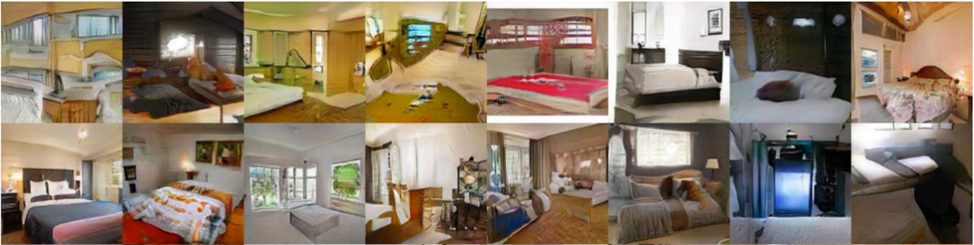
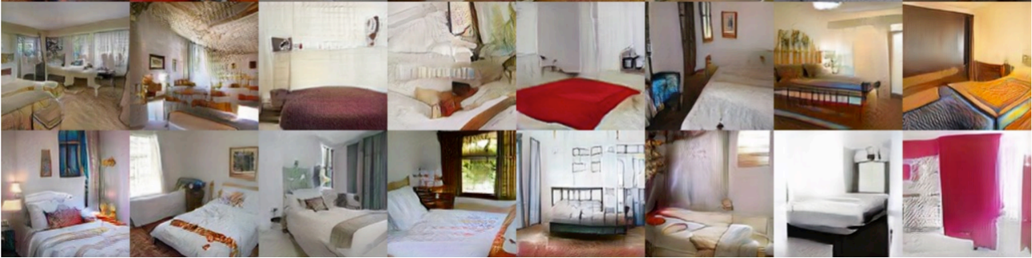
GAN Introduction
Goal: Automatically generate data that are close to real data
Notes:
Widely used in CV area, Photo/Face Synthesis, Image Style Transfer, Image Filling

Slide 4
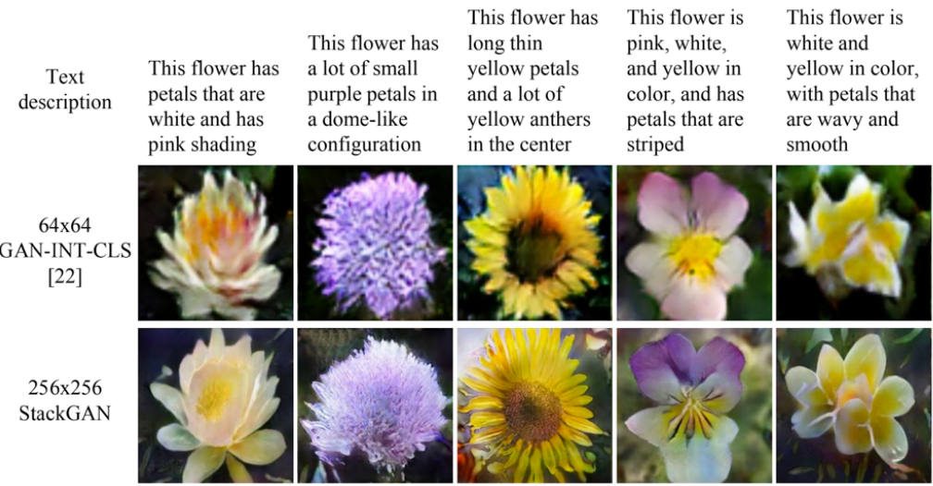
Text-to-Image

Slide 5
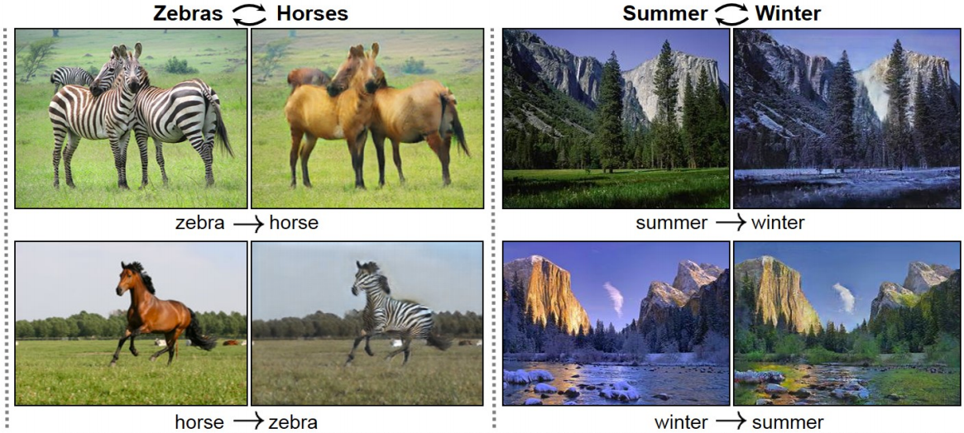
Image Style Transfer

Slide 6
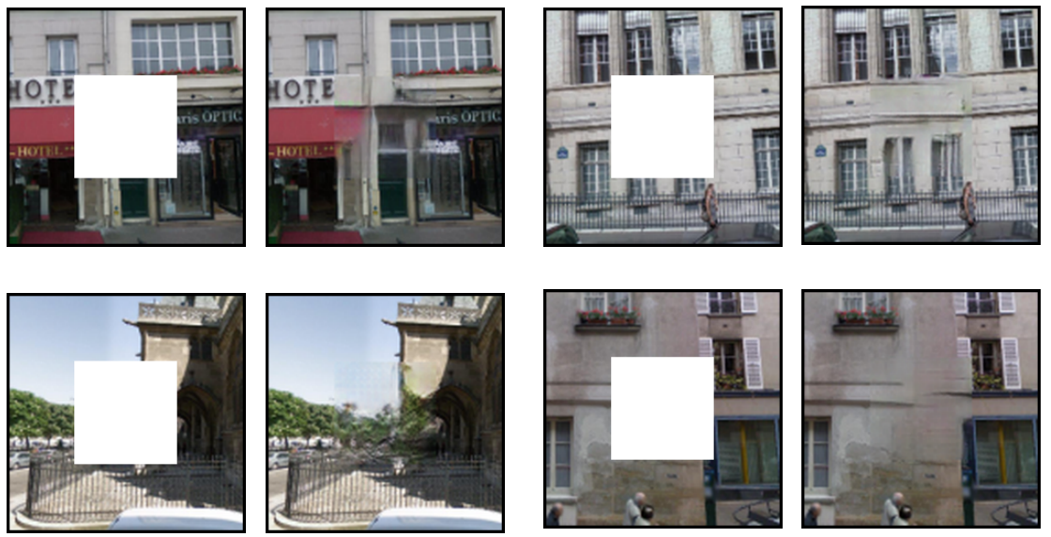
Image Filling
Notes:
Strongly recommend u guys to check out Yanran Li’s tutorial, through the link in the seminar email
I’m not the expert; time is limited

Slide 7
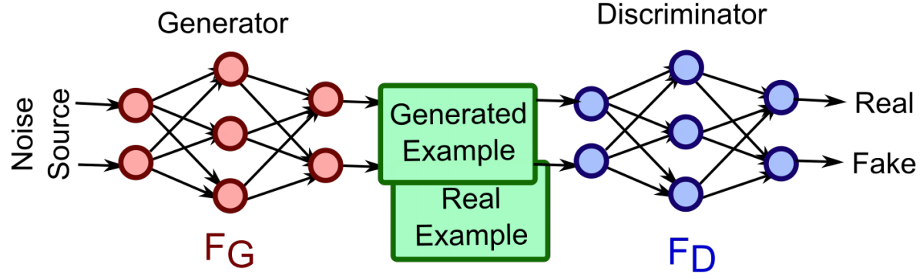
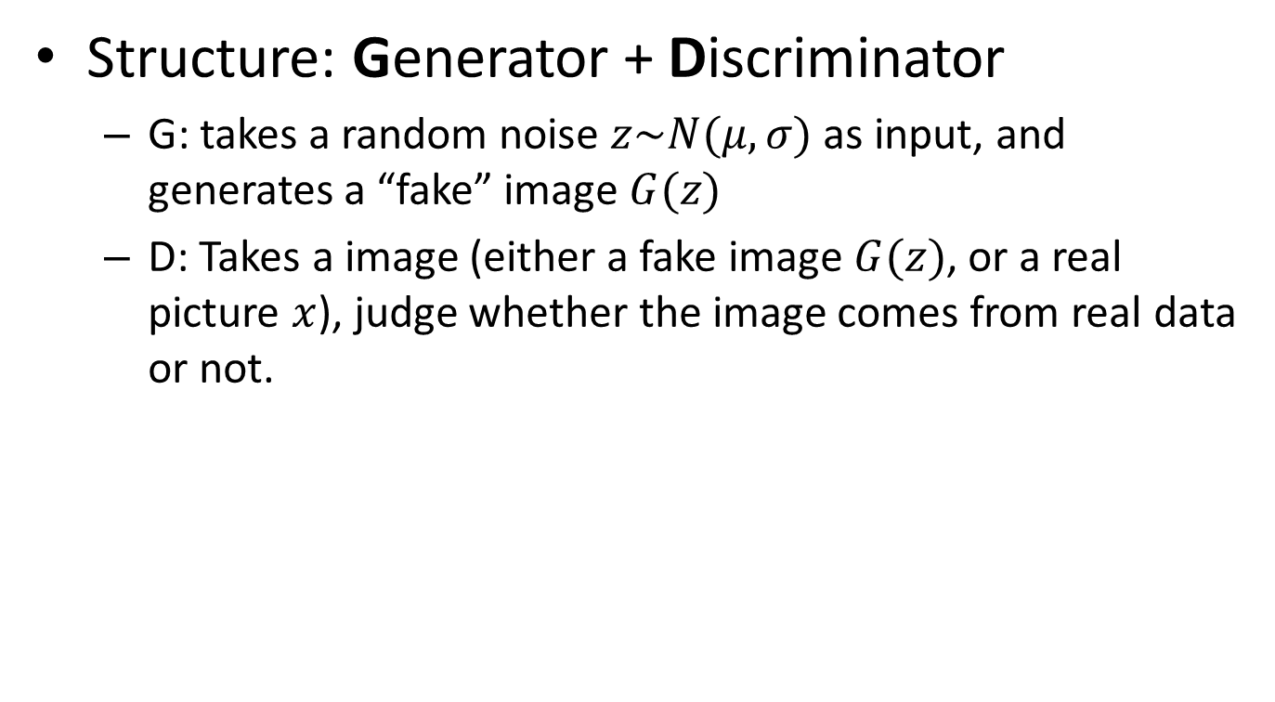
Vanilla GAN
Structure: Generator + Discriminator
G: takes a random noise $z\sim N(μ,σ)$ as input, and generates a “fake” image $G(z)$
D: Takes a image (either a fake image $G(z)$, or a real picture $x$), judge whether the image comes from real data or not.
Notes:
Vanilla GAN
Training data: Real images (unlabeled)
Both G and D could have a structure of multi layer NNs.

Slide 8
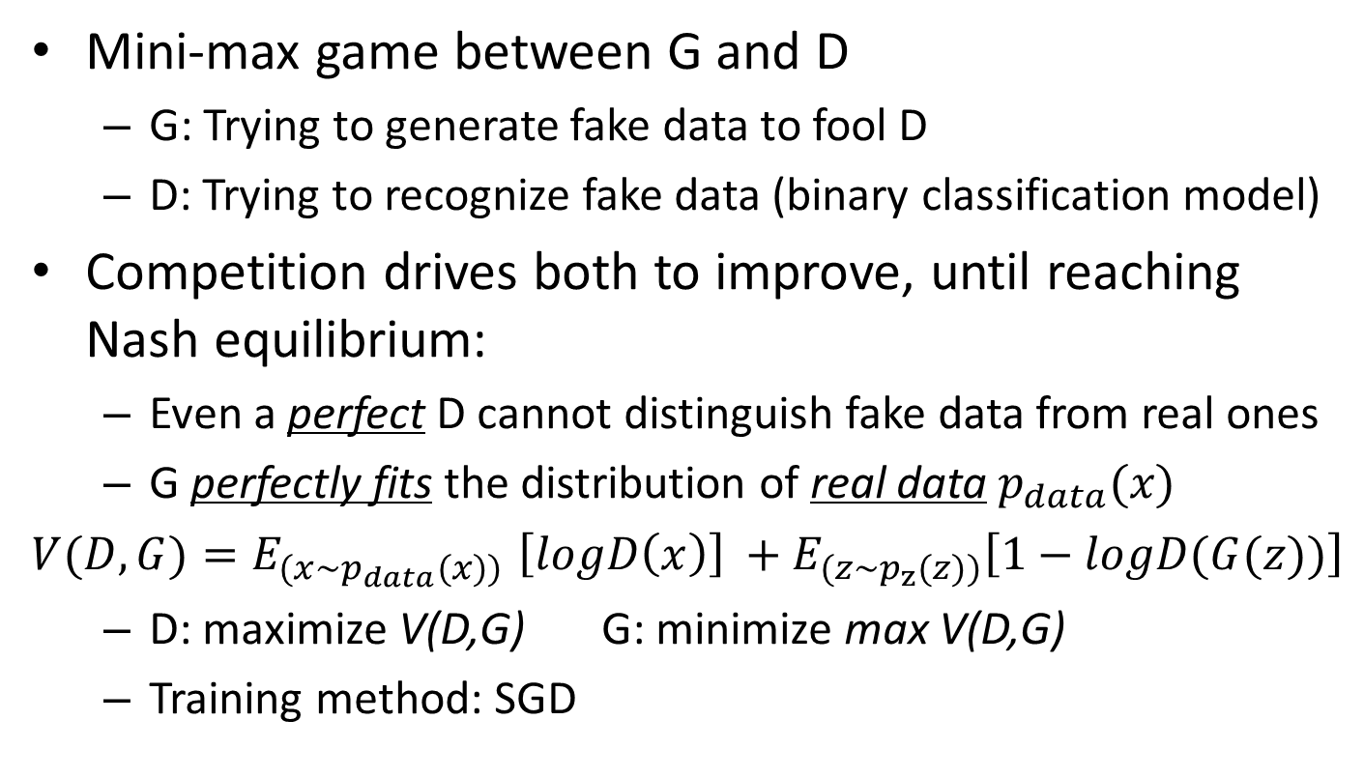
Why GAN Works?
Mini-max game between G and D
G: Trying to generate fake data to fool D
D: Trying to recognize fake data (binary classification model)
Competition drives both to improve, until reaching Nash equilibrium:
Even a perfect D cannot distinguish fake data from real ones
G perfectly fits the distribution of real data $p_{data}(x)$
$V(D,G){=E}_{(x\sim p_{data}(x))}\left[logD\left(x\right)\right] +$ $E_{(z\sim p_{z}(z))}\left[1−logD(G(z))\right]$
D: maximize V(D,G) G: minimize max V(D,G)
Training method: SGD
Notes:
Why such model works? How does G generate images with high quality? 对抗的方式！
G, D goes more and more clever
V(D,G): log-likelihood function of the whole GAN

Slide 9
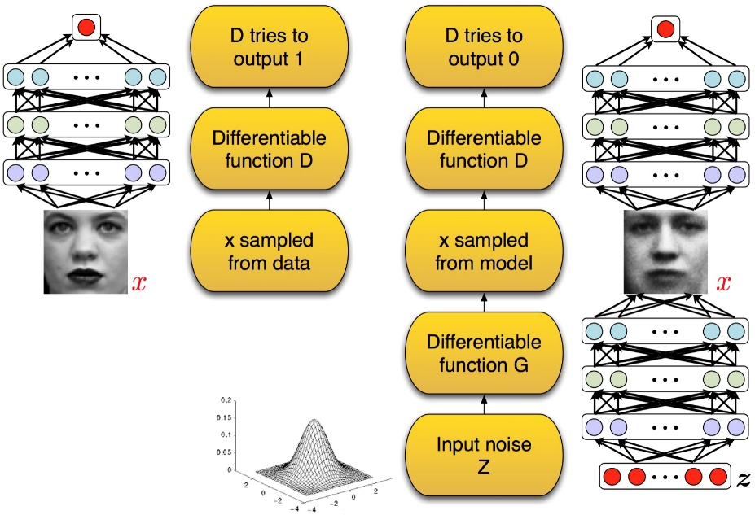
GAN: Real Example
G(z)
D
G
Notes:
loss: back propagate through SGD

Slide 10
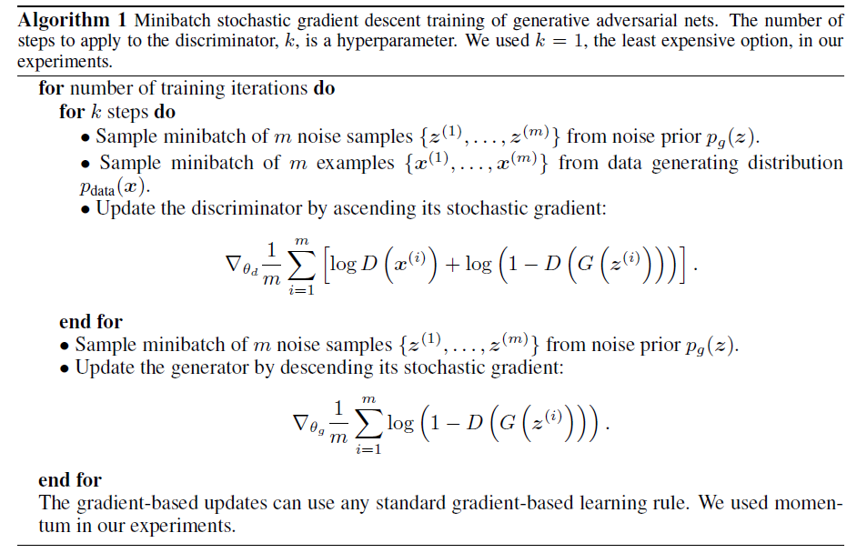
GAN Learning Process
Notes:
Draw something on the board

Slide 11
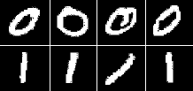
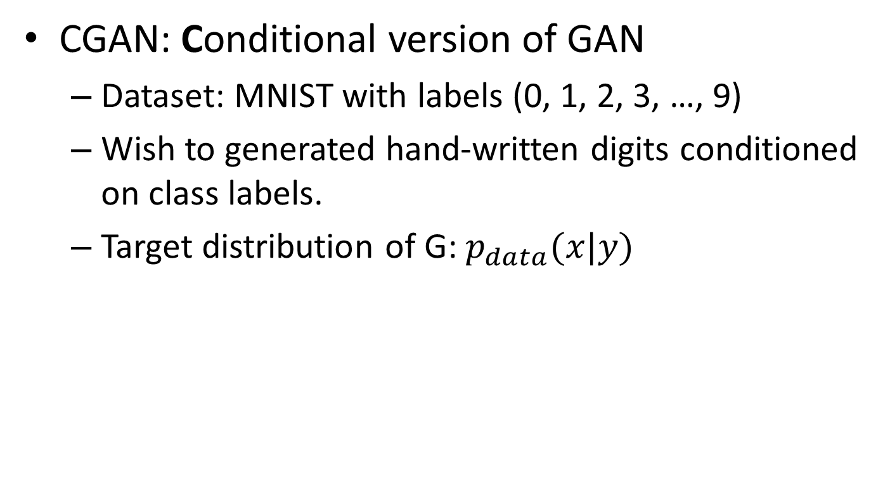
Introduction of CGAN
CGAN: Conditional version of GAN
Dataset: MNIST with labels (0, 1, 2, 3, …, 9)
Wish to generated hand-written digits conditioned on class labels.
Target distribution of G: $p_{data}(x|y)$
Notes:
goal: still generate data, but under some conditions

Slide 12
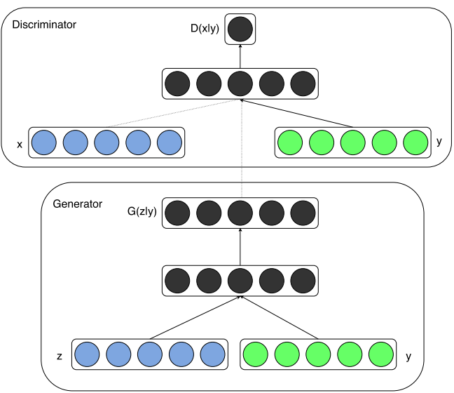
CGAN Architecture
Real Digit
Fake Digit
Random Noise
Class Label
Notes:
class label: 1-hot

Slide 13
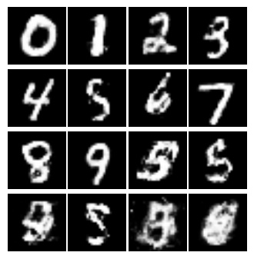
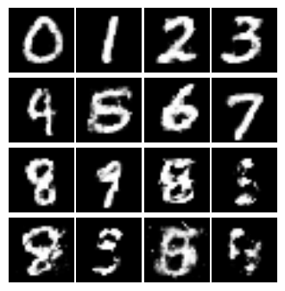
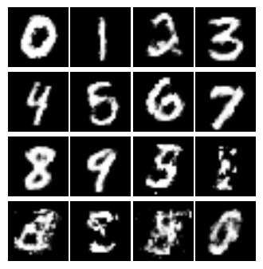
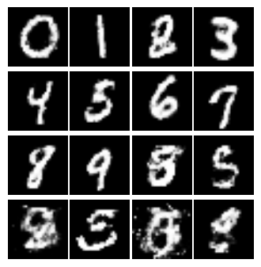
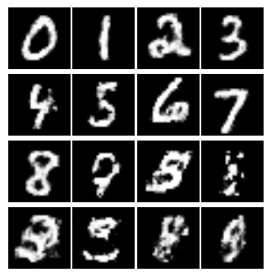
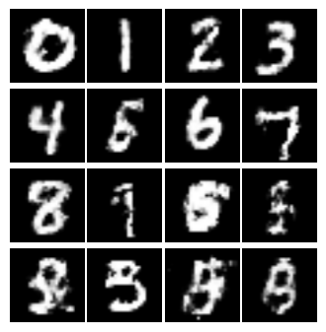
CGAN Running Results
Notes:
After each training iteration, we use GAN to generate 16 digits.
For each output digit, the input noise is randomly sampled, but the underlying class label (y) is given and fixed in advance.
6 results after about 1000 iterations.
Guess the underlying class label

Slide 14
IRGAN
Task: Information Retrieval
A set of queries {q₁, q₂, …, q_{N}}
A set of document {d₁, d₂, …, d_{M}}
Training set: {(q, d, r)} for some query-doc pairs.
relevance level: 2, 1, 0 and -1 (unlabeled)
Goal: Rank all documents based on the relevance of a new query q’
Nothing with automatic data generation!
Notes:
Not for automatically generating data, but for a classification / rank problem.
make sure: -1 means “unknown”, 0 means “no relevance at all”

Slide 15
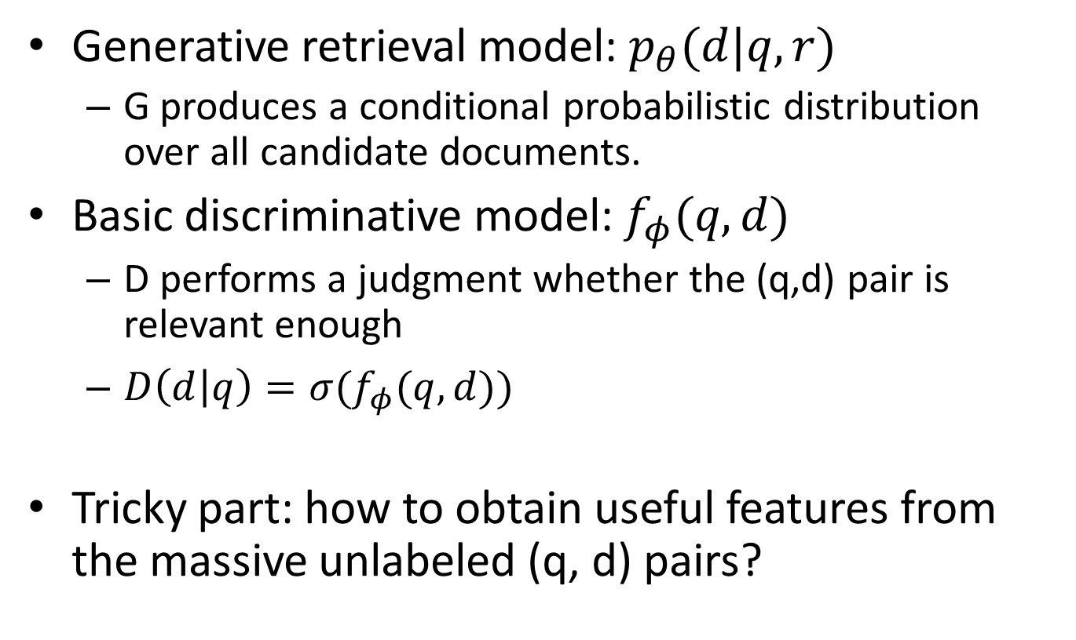
Generative & Discriminative Solutions
Generative retrieval model: $p_{θ}(d|q,r)$
G produces a conditional probabilistic distribution over all candidate documents.
Basic discriminative model: $f_{φ}(q,d)$
D performs a judgment whether the (q,d) pair is relevant enough
$D\left(d | q\right)=σ(f_{φ}(q,d))$
Tricky part: how to obtain useful features from the massive unlabeled (q, d) pairs?

Slide 16
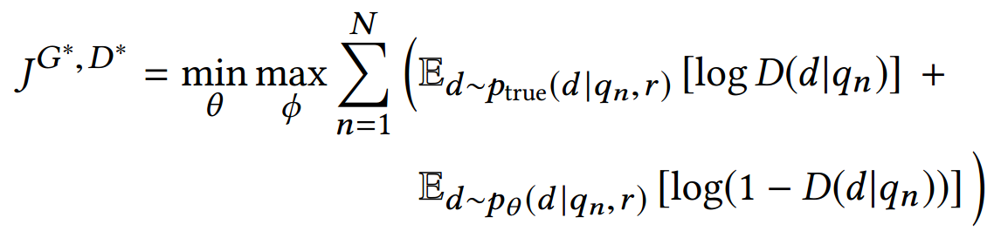
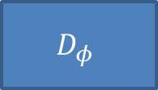
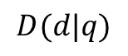
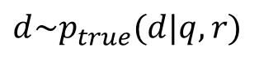
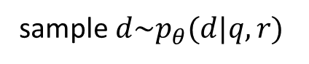
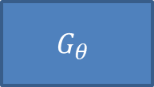
Adversarial Learning for IR task
Solution: Adversarial Learning!
$$G_{θ}$$
sample $d\sim p_{θ}(d|q,r)$
$$D_{φ}$$
or.
$$D(d|q)$$
$$d\sim p_{true}(d|q,r)$$
q

Slide 17


Adversarial Learning for IR task
G: a more and more stronger challenger, who constantly generates fake documents (either labeled or unlabeled ) to confuse D, and pushes D to its limit.
Maximize V(D,G)
Minimize max V(D,G)
D: a more and more perfect human, naturally provides guidance to G to select more confused data from all the documents
Notes:
Note: unlabeled data is far far far more than labeled data
G: generate data close to D’s decision boundary
D: score down generated samples
corrleation between observed positive data and positive but unlabeled samples,
G should be able to push upwards these positive but unlabeled data faster than others.

Slide 18
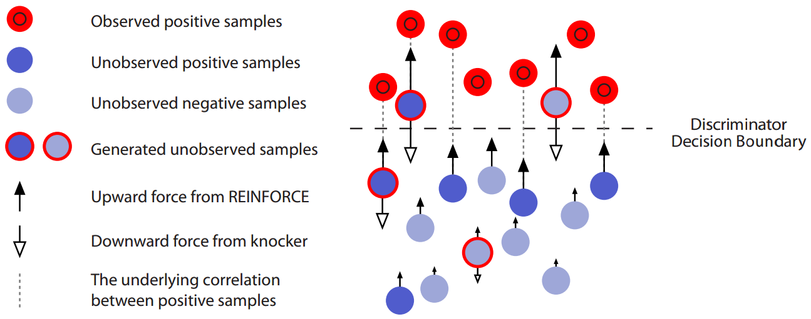
IRGAN Training Illustration
Notes:
D: acts as knocker that kicks down the floating-up soaps
due to the existence of correlations between observed positive and unobserved positive samples,
G: acts as the water that selectively floats the soaps up to the water surface (Decision Boundary)
Could be a dynamic equilibrium, when the distribution of positive and negative soaps get stable at different depth of the water.

Slide 19
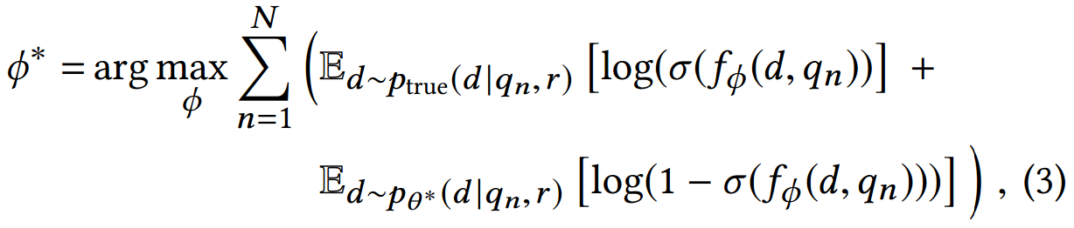
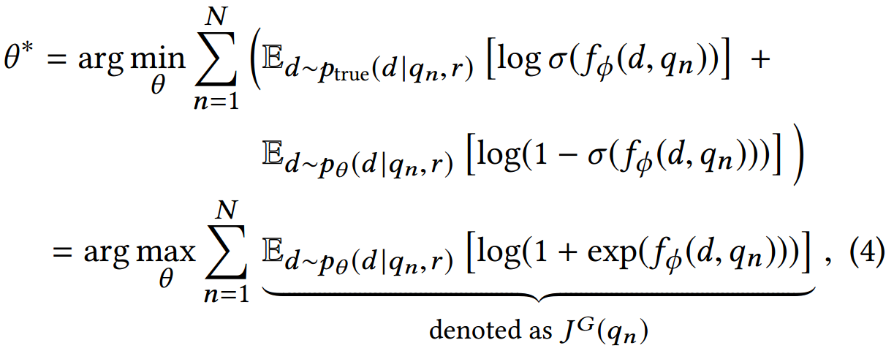
IRGAN: Learning Algorithm
sampling of d is discrete: use policy gradient as instead.
Notes:
Skip it if no time
Talk about some implementation detail: G and D uses the same structure, but with different params.

Slide 20
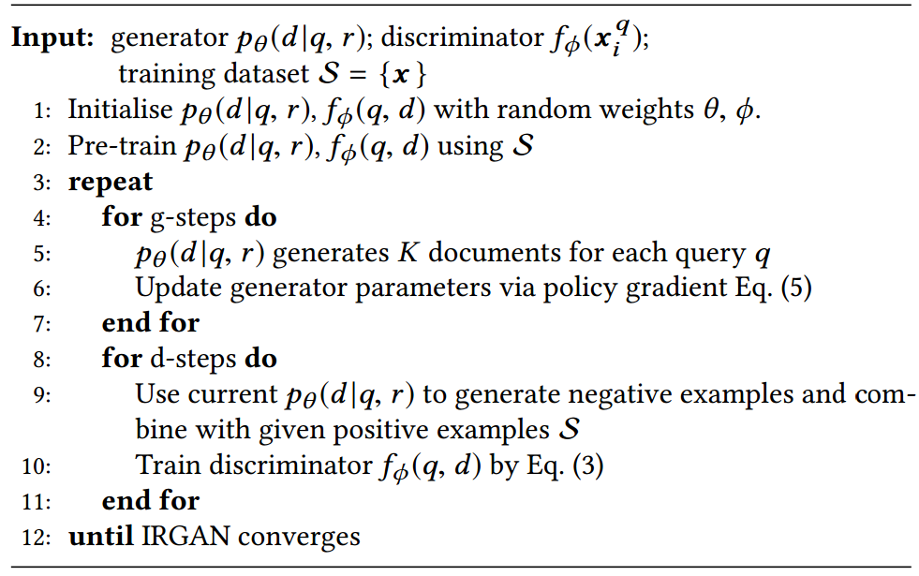
IRGAN: Learning Algorithm

Slide 21
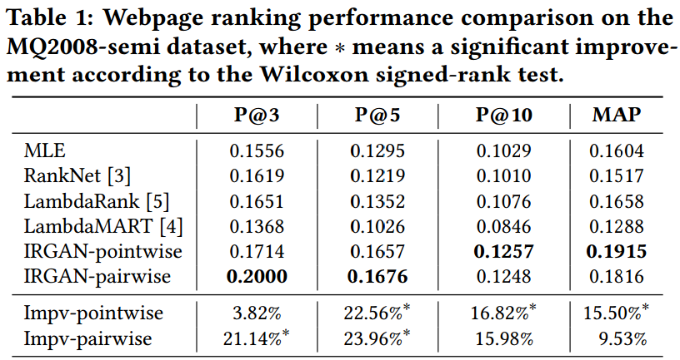
Results on Web Search Task

Slide 22
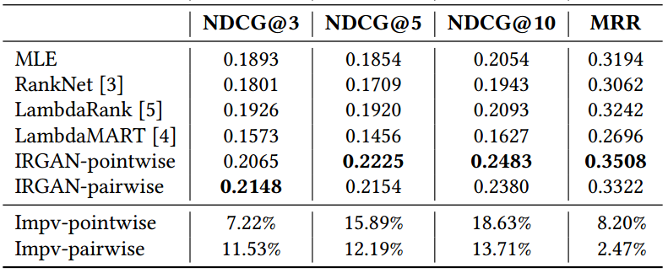
Results on Web Search Task

Slide 23
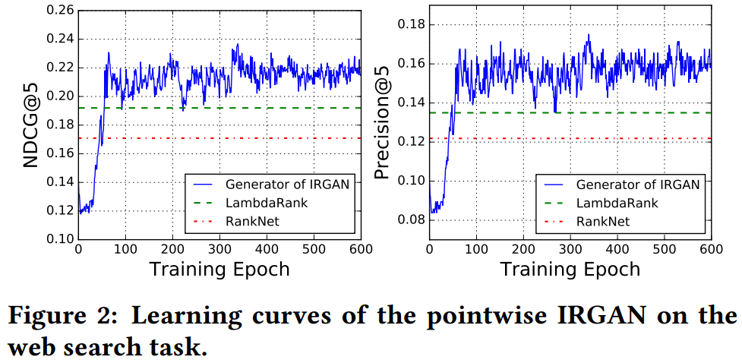
Results on Web Search Task
Notes:
结果抖动 收敛是个问题

Slide 24
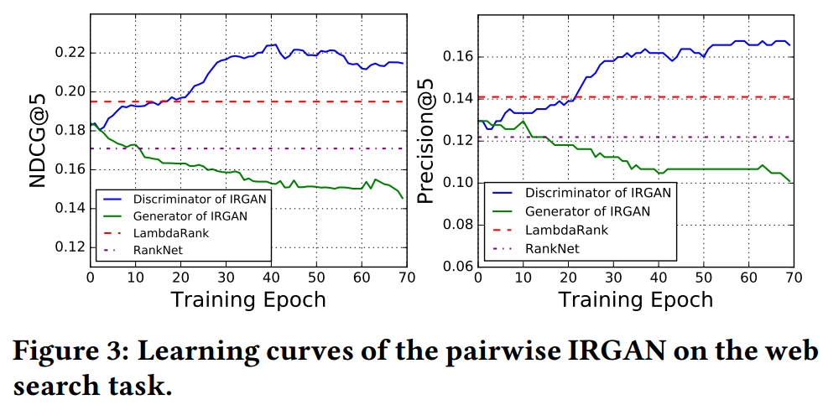
Results on Web Search Task
Notes:
Both G and D can handle the IR task.
D works better than G, but doesn’t know why

Slide 25
Conclusion
CGAN: Used to generate data conditioned on existing knowledge
Text to Image, Style Transfer, Face Synthesis
IRGAN: Can be adapted into other traditional supervised learning problem.
Both G and D can solve the problem independently
Adversarial learning strategy makes use of massive unlabeled data
Still many tricks in GAN:
Non-convergence problem
Collapse problem
Notes:
Non-convergence problem: finding Nash equilibrium is very difficult, because the likelihood function V(D,G) is non-convex, and the dimension of parameter space is extremely high.
Collapse problem: training of GAN is based on Mini-max problem, the loss function is not stable, and it’s hard to say whether the current training has made some progress or not.
Once a collapse problem is occurred, G degenerates and always produce the same data point, and the learning process never continues.

Slide 26
References
Goodfellow et al., “Generative Adversarial Networks”. ICLR 2014.
Mehdi Mirza, Simon Osindero., “Conditional Generative Adversarial Nets”. Arxiv 2014.
Jun Wang, Lantao Yu, Weinan Zhang, Yu Gong, Yinghui Xu, Benyou Wang, Peng Zhang, Dell Zhang. “IRGAN: A Minimax Game for Unifying Generative and Discriminative Information Retrieval Models”. SIGIR 2017.

Slide 27
Thanks for listening!
Question & Answers

